Slide 1
Project Seminar
2
Project Management
Dr Alex Lohfink
1

Slide 2
Today's lecture
Recap
Bit about the ethics form
Time management
GANNT chart
Practicalites
Handling pressure

Slide 3
Every Project should have
Clear Aims and Objectives – What am I going to develop & why?
Literature Review /
Selection of appropriate tools
Prototyping
Previous work
Who is it aimed at etc.

Slide 4
Every Project should have
Clear OUTPUTS
Design -based on outputs
Prototype - based on design
Evaluation of prototype (scope)… BY WHO?
Conclusions

Slide 5
Key dates
Objectives / Marking Scheme/Ethics Form – End of w/c 11th October, 2019
Interim report - Initial Research etc - Friday 22nd November, 2019 (10%)
Final Report - Friday 29th March, 2019
VIVA - ‌Monday 27 April - Friday 15th May 2020
4

Slide 6
A project topic must >>
be a problem which involves significant design decision making and includes a
critical evaluation of alternatives using formal and judgmental criteria.
involve the project progressing through the following stages:
Research and investigation
Design and development of a solution to the project
Implementation
Evaluation and critique of the solution(s)
Dissertation
A formal presentation identifying the project’s progress through the stages identified above.
5

Slide 7
Faculty Ethics ApprovalForm
2 page form
Complete during your first meeting
Get supervisor to send to me
Will be a problem if not completed

Slide 8
GoodProject Progress
» Clear idea of what you are doing and why - strong project proposal
» Focus on the CORE issues
» Apply knowledge/skills to non-trivial issues
» Self manage your time and progress - with reference to your first assessor
» Things (report writing, research, application, design, etc) should improve with progress of your project
» Address weaknesses as you progress
21

Slide 9
Planning and Time Management
» 13 hour per week on project
» i.e. if you are ‘working’ a 40 hour week - nearly one third of your study time should be spent on your project!!!
» Be realistic -> time plan should be adhered to as far as possible

Slide 10
Planning and Time Management
Leaving to the last couple of weeks/months - prone to failure!
Large undertaking - break it down
Apply careful thought and analysis to identify manageable component parts.
Begin soon as possible
Work consistently throughout the year
Track progress closely.

Slide 11
Planning and Time Management
project schedule is essential
forces you to identify the things you need to do
allocate time to tasks and sub-tasks
Identify all the major tasks
Break these down into sub-tasks

Slide 12
Planning and Time Management
For each task and subtask:
Estimate task effort & duration:
estimate effort you expect it to take (hours)
what period you will spread that effort over (days):
identify the required inputs
information, software, hardware, the results of other tasks in your project.
Identify the expected outputs
Identify course of action if the task fails (e.g. the software or hardware doesn’t arrive in time)
identify the sequence od tasks

Slide 13
Planning and Time Management
Schedule gives you a framework as a reference
Don't feel shackled by it

Slide 14
Planning and Time Management
Can use a standard project management tool (such as Microsoft Project).
GANNT chart

Slide 15
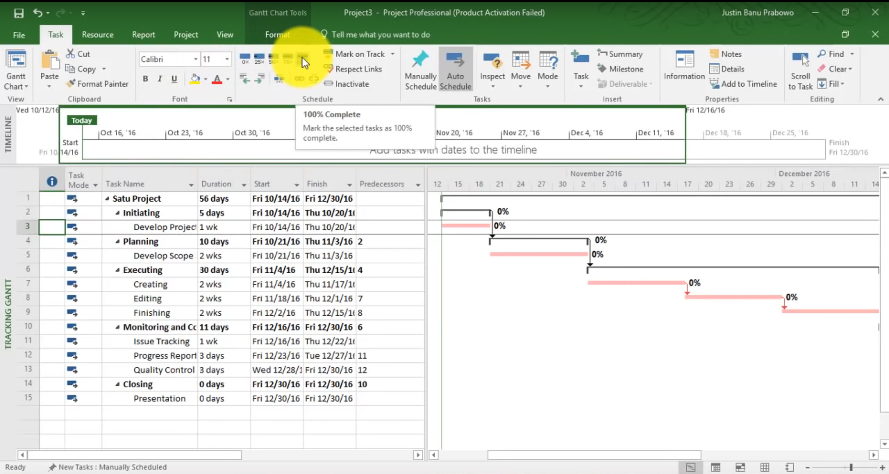

Slide 16
Practicalites
Tasks tend to take longer than anticipated
Getting access to information (esp. data) may be difficult
Remember things like ethics, formatting, word count, structure
Academic rigour
Meetings
Competing activities (other modules)
Plagiarism
Handling pressure
Use everything at your disposal

Slide 17
Handling pressure
Managing deadlines
Keep on top of courseworks
Extenuating circumstances
Prioritise

Slide 18
Prioritising tasks
A - Important and urgent
B - Urgent but not important
C - Important but not urgent
D - Not important or urgent

Slide 19
Manage content
Academic rigour
Be consise
No upside to being overly verbose
Beware big claims/statements
These will be tested a viva
Link sections

Slide 20

Children who Eat Fish are More Intelligent
Academic rigour
a Hypothesis
Example ‘borrowed’ from Essential Guide to Doing Your Research Project O’Leary (2014)

Slide 21
Radio report:
“Eating Fish Increases Your IQ”
Children who eat fish at least once a week have a higher IQ than their non-fish eating peers
The above MUST be true -> it said it on the radio
Various results were looked at: diet, education, socio-economic status, age of parents, parental marital status and parent education level
Therefore selection of a single variable to ‘support the hypothesis’
i.e. at one correlation EATING FISH AND IQ increased -> or reverse it ‘the more intelligent you are then the more fish you will eat’?

Slide 22
Academic rigour
» "Passenger numbers have increased since privatisation, so clearly nationalisation doesn't work......"

Slide 23
22

